Slide 1
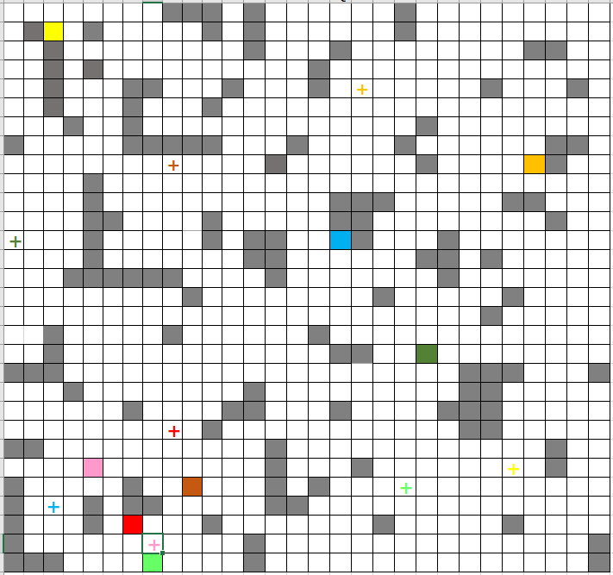
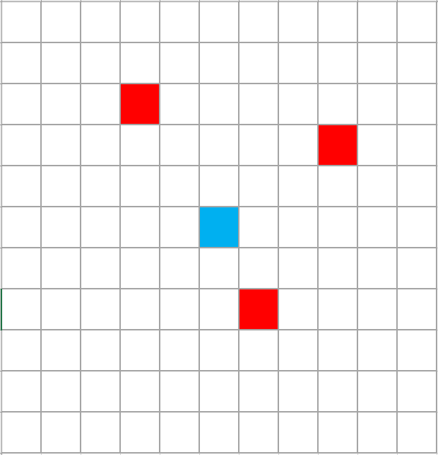
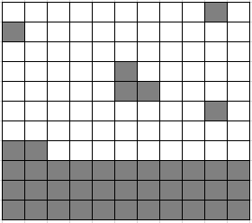
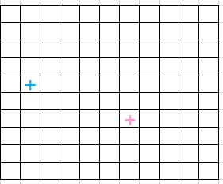
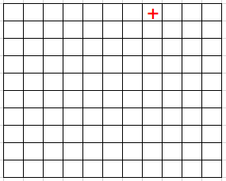
Agents
Goals
Obstacle

Slide 2
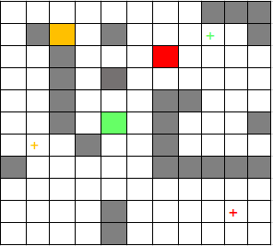
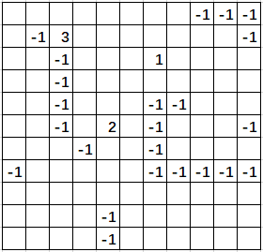
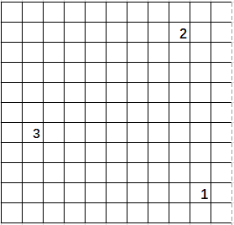
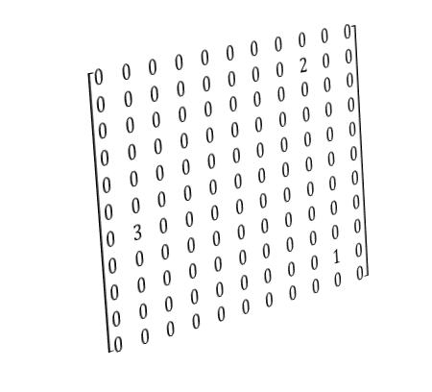
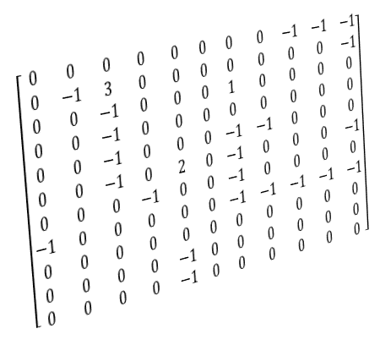
$$\left[\begin{matrix}0 & 0 & 0 & 0 & 0 & 0 & 0 & 0 & −1 & −1 & −1 \\ 0 & −1 & 3 & 0 & 0 & 0 & 0 & 0 & 0 & 0 & −1 \\ 0 & 0 & −1 & 0 & 0 & 0 & 1 & 0 & 0 & 0 & 0 \\ 0 & 0 & −1 & 0 & 0 & 0 & 0 & 0 & 0 & 0 & 0 \\ 0 & 0 & −1 & 0 & 0 & 0 & −1 & −1 & 0 & 0 & 0 \\ 0 & 0 & −1 & 0 & 2 & 0 & −1 & 0 & 0 & 0 & −1 \\ 0 & 0 & 0 & −1 & 0 & 0 & −1 & 0 & 0 & 0 & 0 \\ −1 & 0 & 0 & 0 & 0 & 0 & −1 & −1 & −1 & −1 & −1 \\ 0 & 0 & 0 & 0 & 0 & 0 & 0 & 0 & 0 & 0 & 0 \\ 0 & 0 & 0 & 0 & −1 & 0 & 0 & 0 & 0 & 0 & 0 \\ 0 & 0 & 0 & 0 & −1 & 0 & 0 & 0 & 0 & 0 & 0\end{matrix}\right]$$
State Map
$$\left[\begin{matrix}0 & 0 & 0 & 0 & 0 & 0 & 0 & 0 & 0 & 0 & 0 \\ 0 & 0 & 0 & 0 & 0 & 0 & 0 & 0 & 2 & 0 & 0 \\ 0 & 0 & 0 & 0 & 0 & 0 & 0 & 0 & 0 & 0 & 0 \\ 0 & 0 & 0 & 0 & 0 & 0 & 0 & 0 & 0 & 0 & 0 \\ 0 & 0 & 0 & 0 & 0 & 0 & 0 & 0 & 0 & 0 & 0 \\ 0 & 0 & 0 & 0 & 0 & 0 & 0 & 0 & 0 & 0 & 0 \\ 0 & 3 & 0 & 0 & 0 & 0 & 0 & 0 & 0 & 0 & 0 \\ 0 & 0 & 0 & 0 & 0 & 0 & 0 & 0 & 0 & 0 & 0 \\ 0 & 0 & 0 & 0 & 0 & 0 & 0 & 0 & 0 & 0 & 0 \\ 0 & 0 & 0 & 0 & 0 & 0 & 0 & 0 & 0 & 1 & 0 \\ 0 & 0 & 0 & 0 & 0 & 0 & 0 & 0 & 0 & 0 & 0\end{matrix}\right]$$
Goal Map

Slide 3
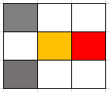
y
y
2
2
1
1
2
1
1
2
0
0
0
1
2
0
1
2
x
x
AgentID | current state | next action | next state | collide?
1 | (1,1) | right | (1,1) | True
2 | (2,1) | left | (2,1) | True
AgentID | current state | next action | next state | collide?
1 | (1,1) | right | (2,1) | False
2 | (2,1) | left | (2,2) | False

